Slide 1


Phishing Awareness Simulation Using Social Engineering Techniques
Major Project · Cyber Security Internship
Prepared by: Aditya Sanjay Kamble
Organization: Naviotech Solutions Pvt. Ltd.

Slide 2
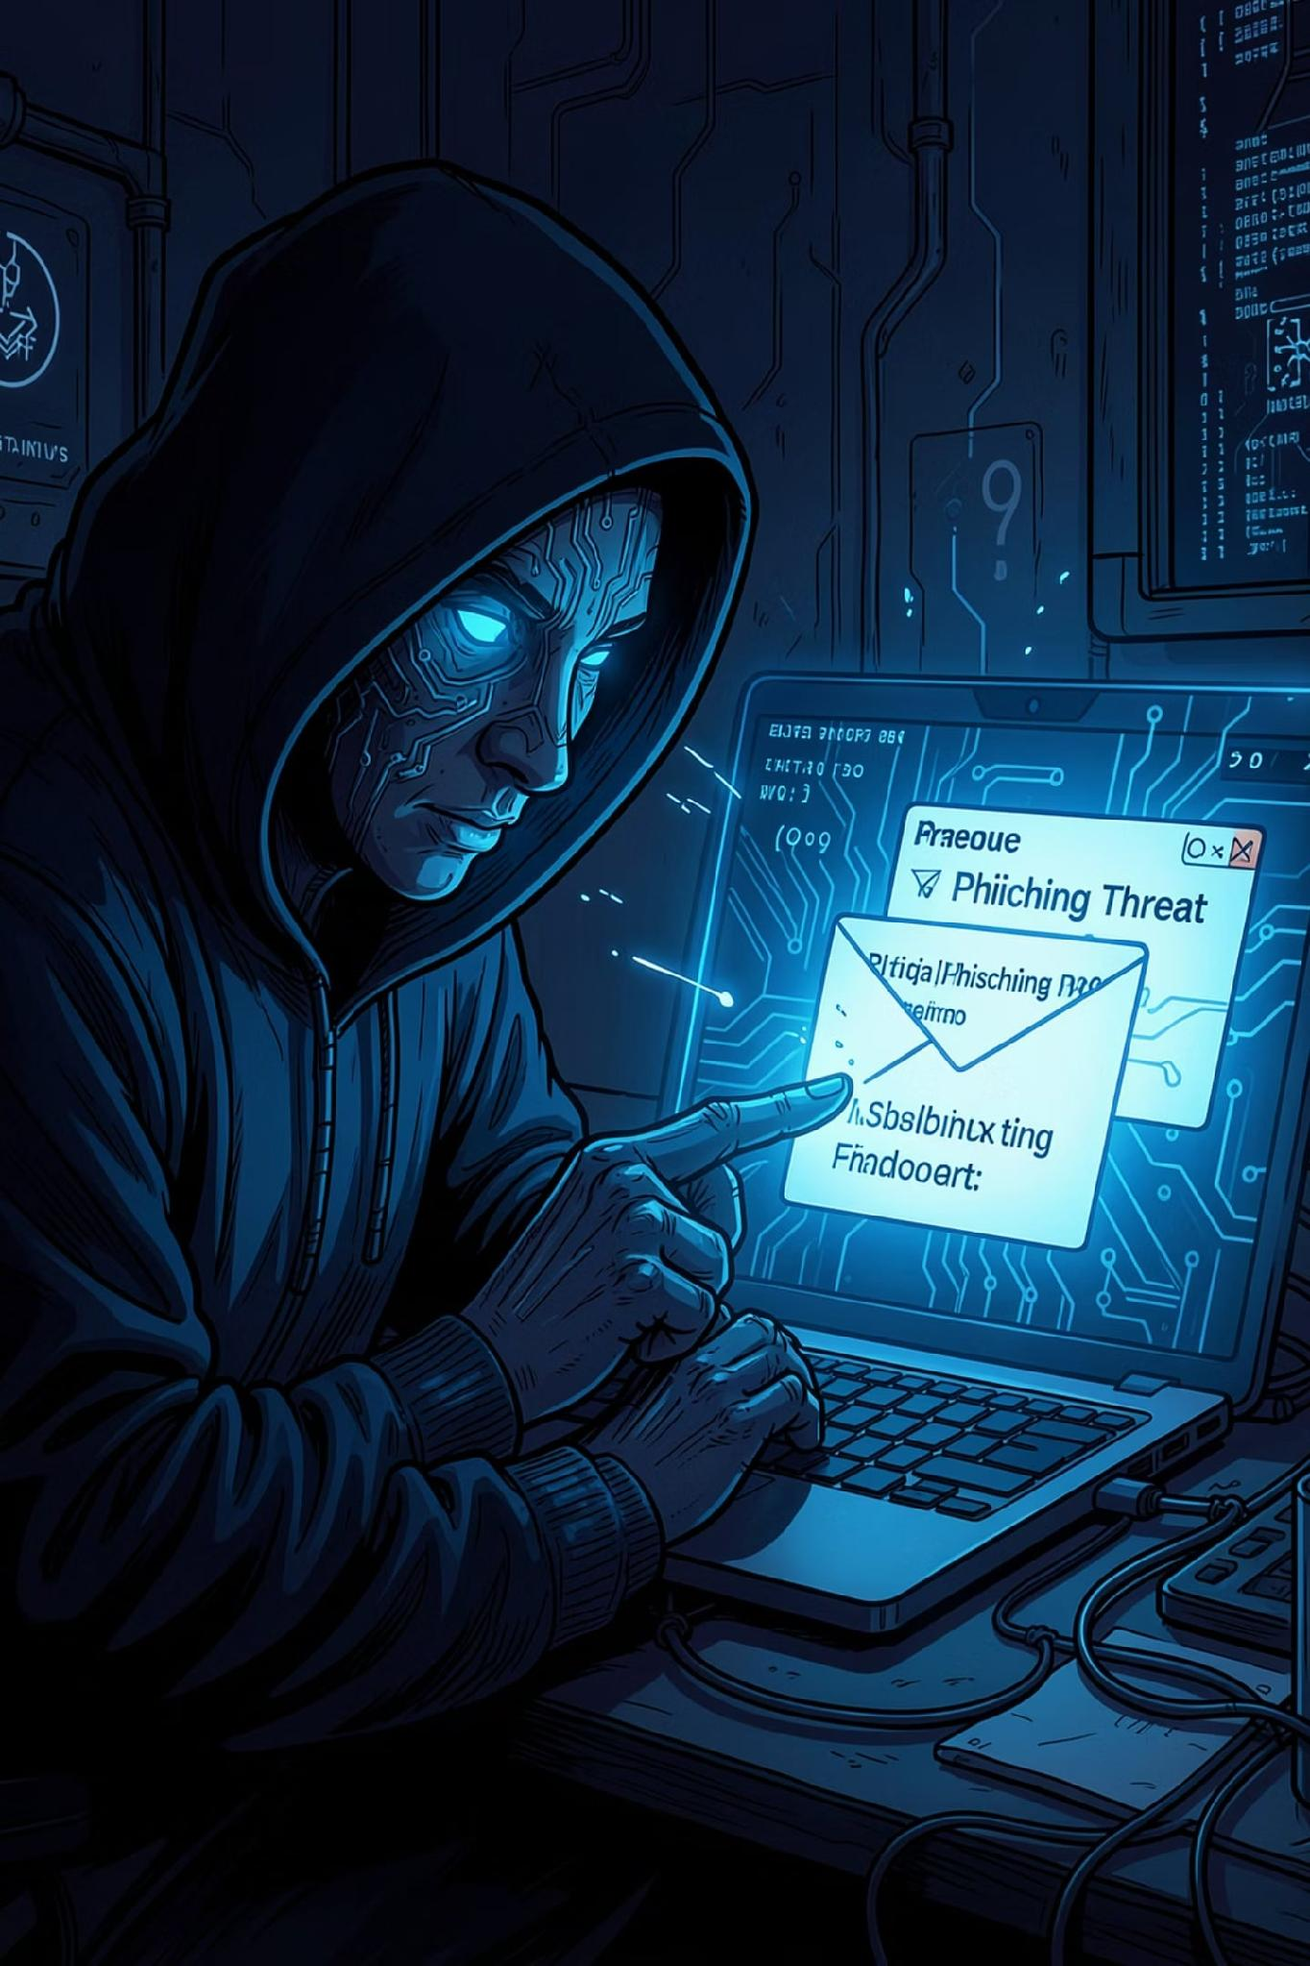
What Is Phishing?
Phishing is one of the most prevalent cyber threats today — attackers craft deceptive emails, messages, or websites that appear legitimate to trick users into revealing sensitive credentials such as usernames and passwords.
Social Engineering
Objective
Exploits human trust, urgency, and fear rather than technical vulnerabilities.
Conduct an ethical, controlled phishing simulation to raise awareness and measure user susceptibility.
Ethical Scope
No real credentials are collected or stored. The exercise is purely educational.

Slide 3

Project Methodology
The simulation followed a structured, ethical workflow — from research through design, execution, and analysis — ensuring participant safety and educational value at every stage.
Research
Design
Develop
Simulate
Observe
Each phase was designed to be non-invasive and fully transparent to participants, aligning with ethical cybersecurity research practices.

Slide 4
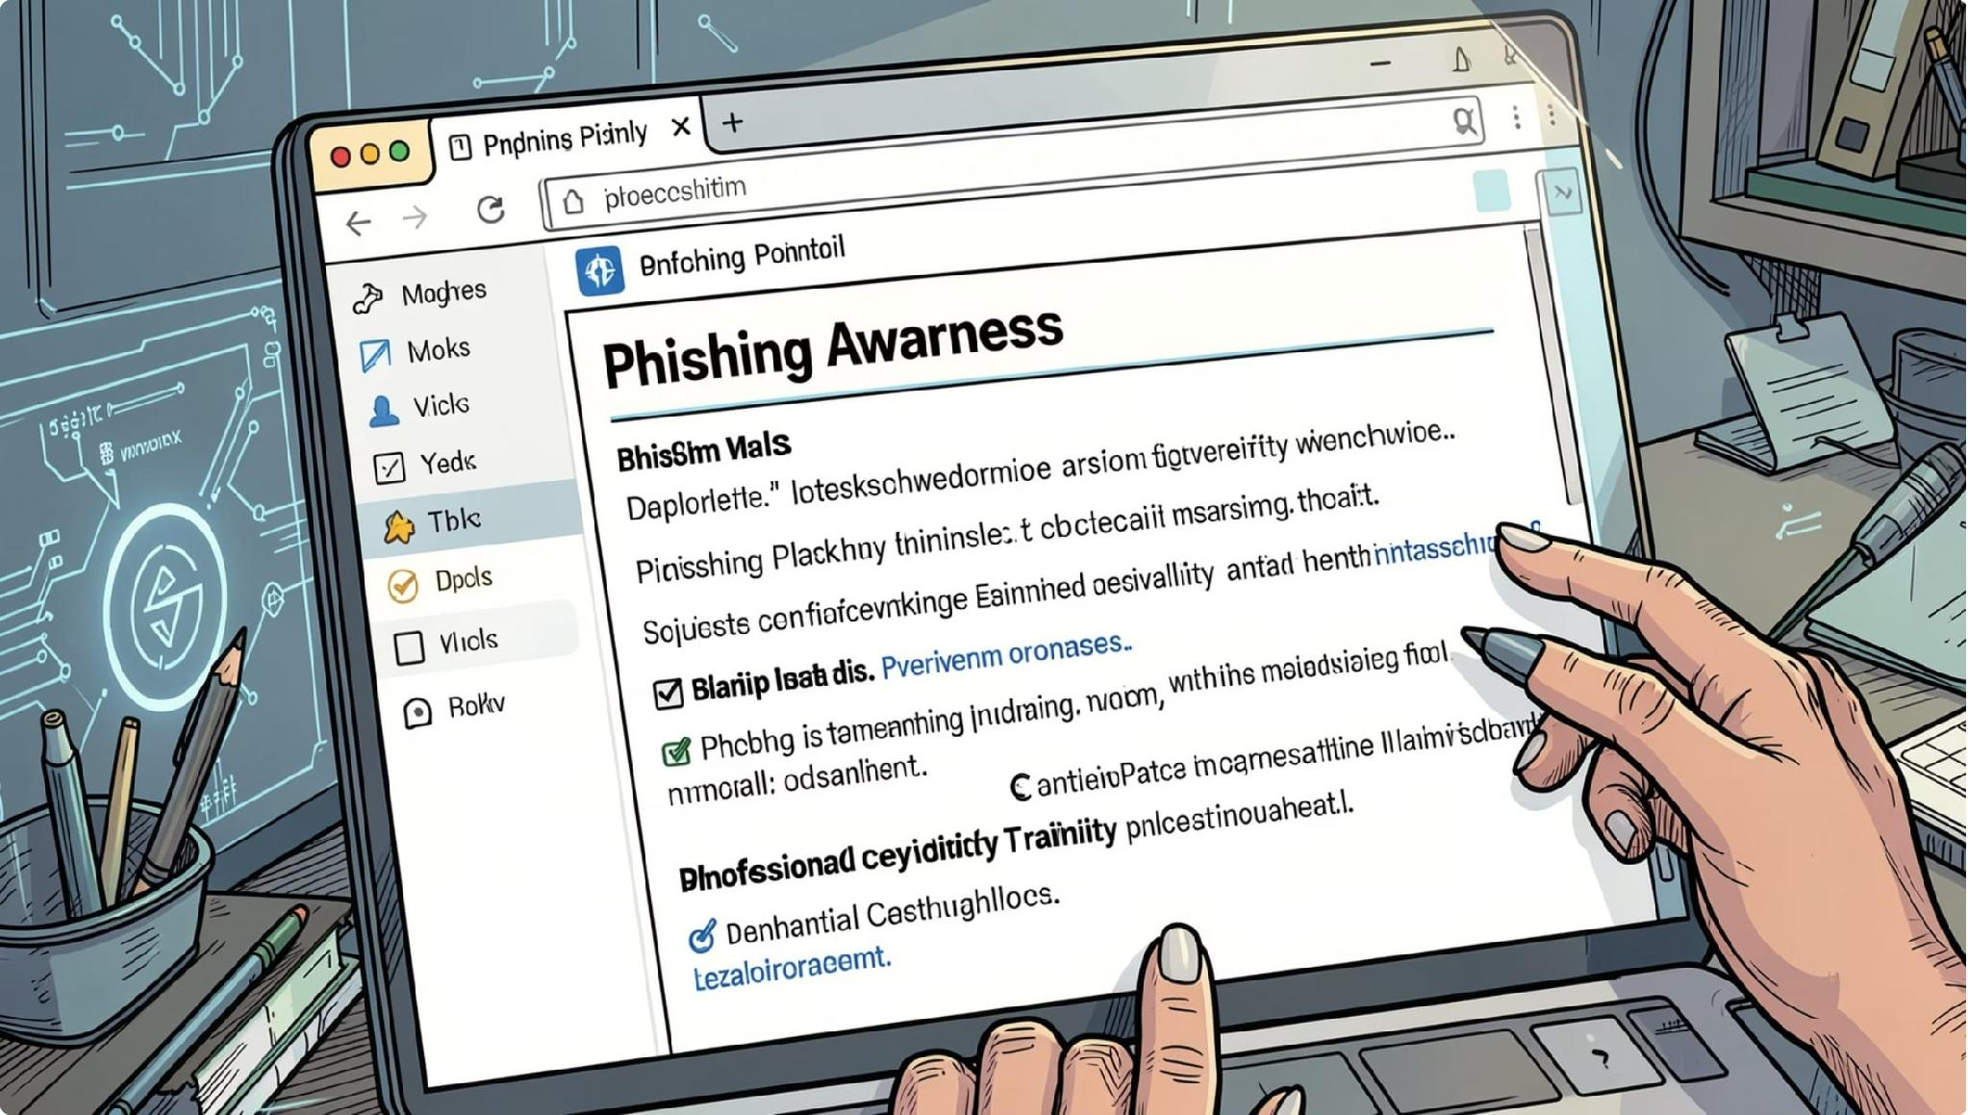

Demonstration & Results
What Participants Saw
A realistic but clearly labeled phishing email prompted users to click a link and enter credentials on a demonstration HTML login page. Upon submission, an awareness message was displayed explaining the simulation.
All data shown is sample demonstration data unless real awareness exercise results are available.
Participant Response Summary
Observation
Count
Total Participants
20
Clicked Link
8
Reported Email
7
Ignored Email
5

Slide 5







Lessons Learned & Preventive Measures
Key Lessons Learned
Organizational Preventive Measures
Verify sender email addresses before trusting any message.
Multi-Factor Authentication
Adds a critical second layer of defense.
Check website URLs carefully — look for misspellings or suspicious domains.
Security Awareness Training
Do not act on urgent or threatening emails without verification.
Regular training reduces human error.
Email Filtering
Report suspicious emails to your IT or security team immediately.
Blocks malicious messages before they reach users.
Strong Password Policy
Enforce complexity and rotation requirements.
Software Updates
Patch vulnerabilities promptly across all systems.
Verify HTTPS Websites
Ensure sites use encrypted connections.

Slide 6

Conclusion
Phishing attacks exploit human behavior, not just technical weaknesses. This project demonstrated that a well-designed, ethical awareness simulation can effectively educate users — without collecting or storing any real credentials.
Human-Centric Threat
Training Works
Attackers target psychology, not systems.
Regular awareness programs significantly reduce susceptibility.
Ethical by Design
Simulations educate without compromising user data.

